Slide 1
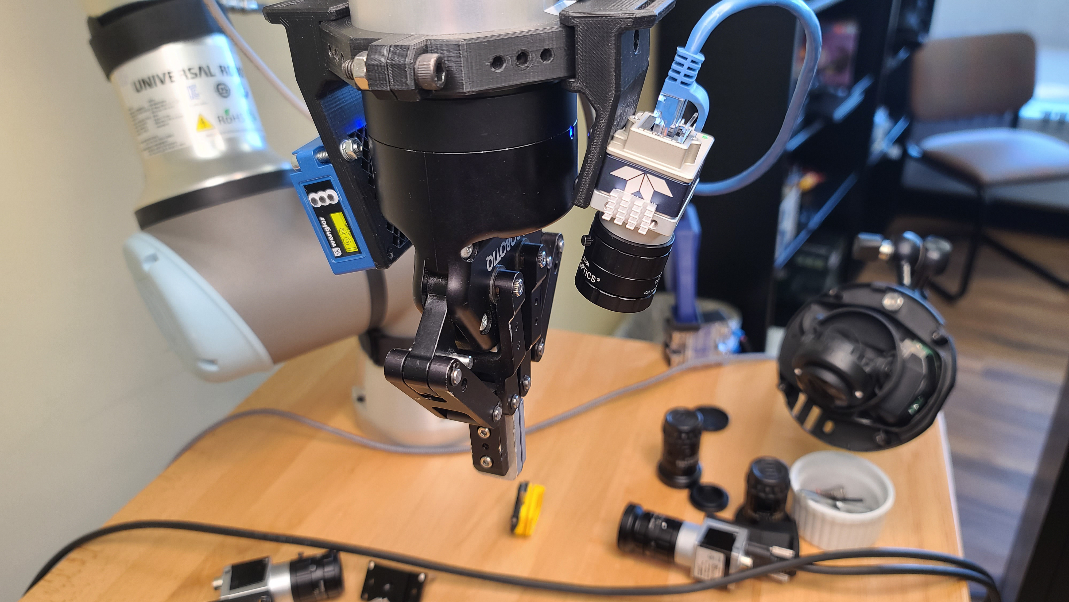

CSC485B Machine Learning for Robotics
SUNY Plattsburgh
Dr. Ned Lecky
Class 08- Working Together on Pythagoras

Slide 2
Just Two Items Today
Brief overview of Olis Connect
https://olisrobotics.com/remote-control-for-universal-robots
Some help/working together on the Pythagoras assignment

Slide 3
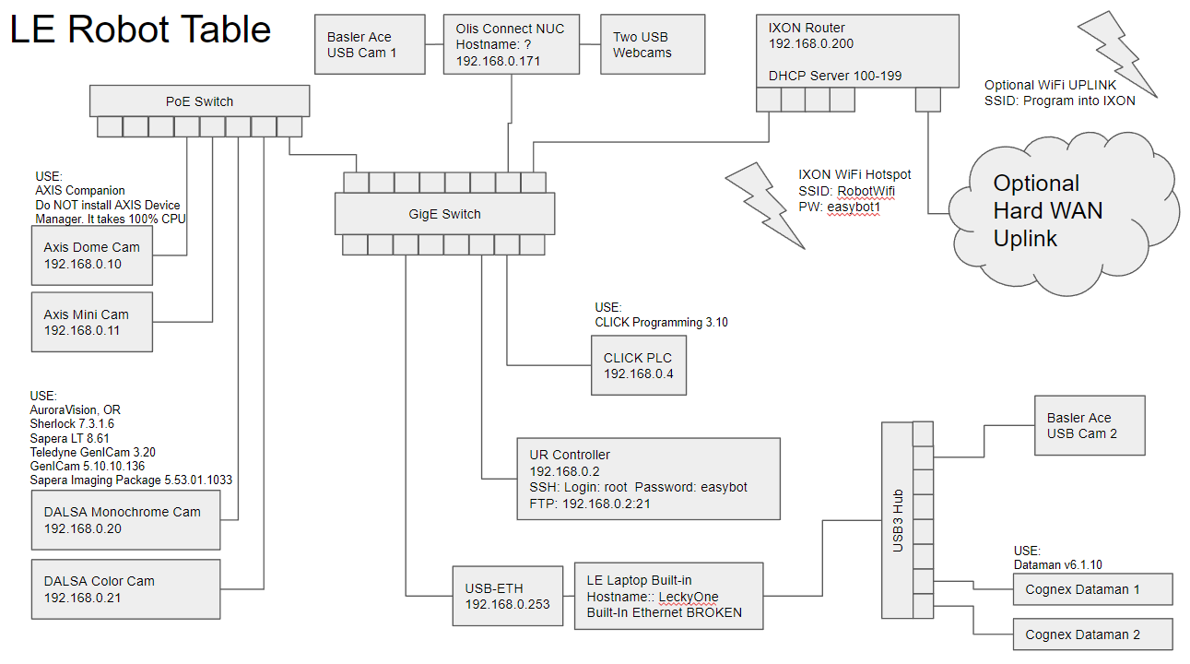
Olis Connect Network
Using Tailscale VPN to connect directly to the Olis Connect NUC
Then we can jog, program, and experiment!

Slide 4
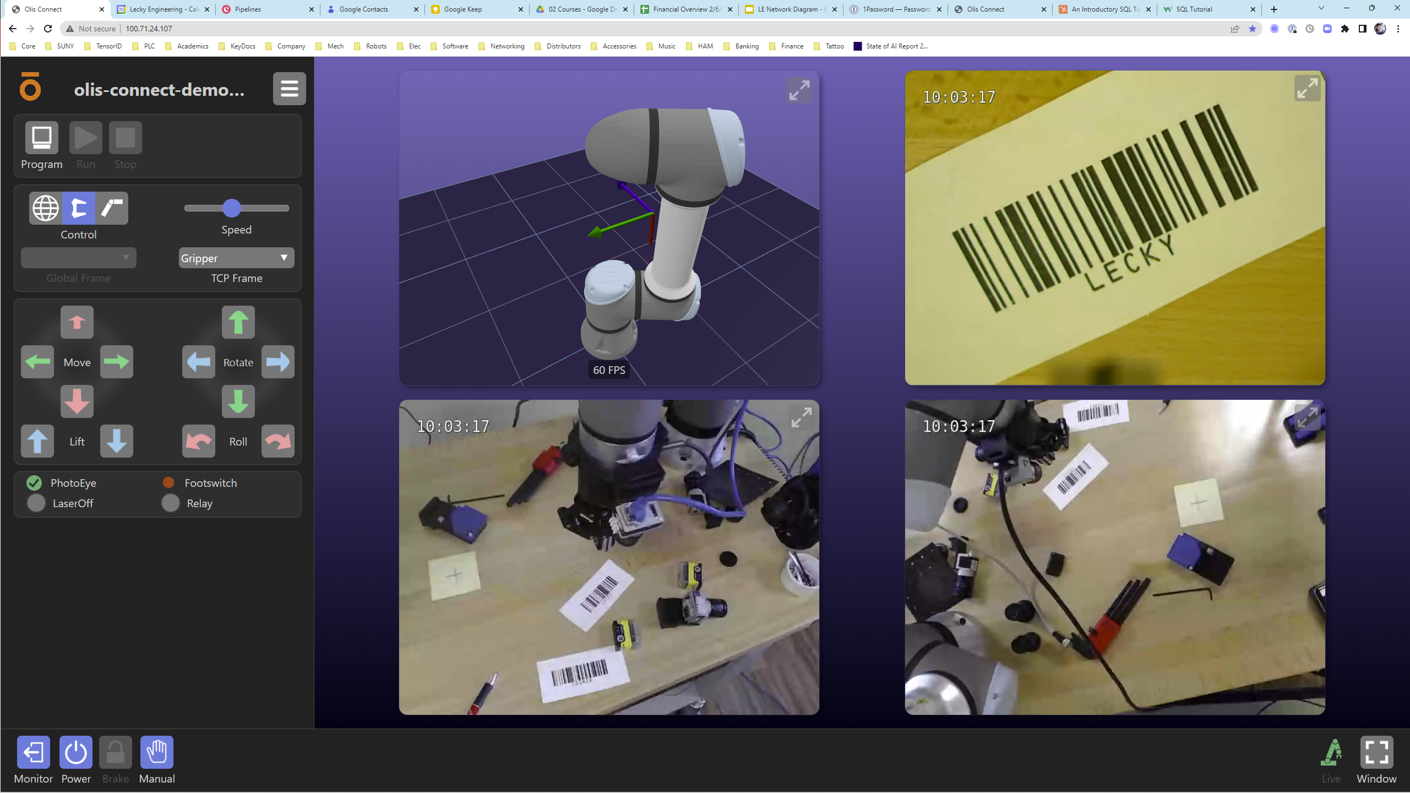
Online with Olis Connect

Slide 5
Code Chalk Talk
Some help/working together on Pythagoras
https://github.com/nedlecky/CSC485B/blob/main/CSC485_130_PythagorasInSteps.ipynb
And… yes! It’s OK to update your ideas and hand in before next class!

